Slide 1

Mini Capstone Project
Attili Lakshmi Rajeswari
S10614

Slide 2
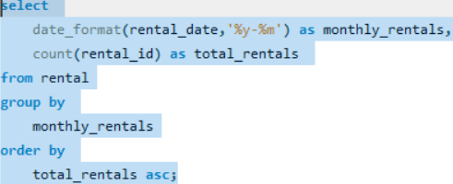
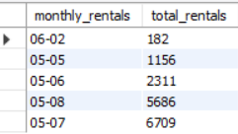
1. Rental Trends: a. Analyze the monthly rental trends over the available data period.
Output:

Slide 3
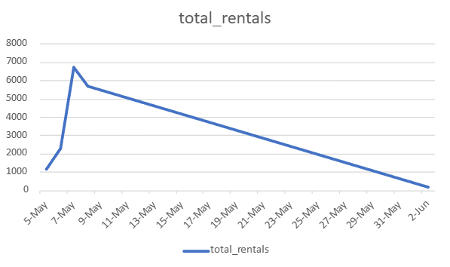
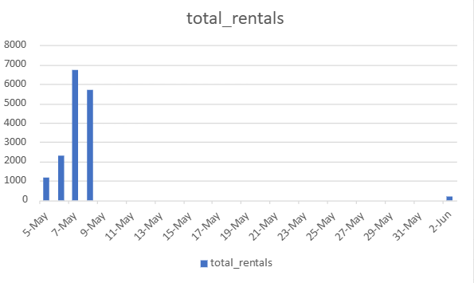
Visualization & Report
The Highest Rentals occurred in 7th May with 6,909 rentals, having peak rentals in May.
Also shows significant drop in June.

Slide 4
Recommendations:
Significant drop in June may be due to seasonal trends or external factors like Opening of schools or colleges.
Have to done some campaigns to know more about the significant drop in June from the regular customers.
Giving additional discounts or package deals or doing engaging programs for the customers.

Slide 5
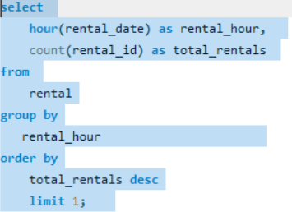

1. Rental Trends: b. Determine the peak rental hours in a day based on rental transactions.
Output:

Slide 6
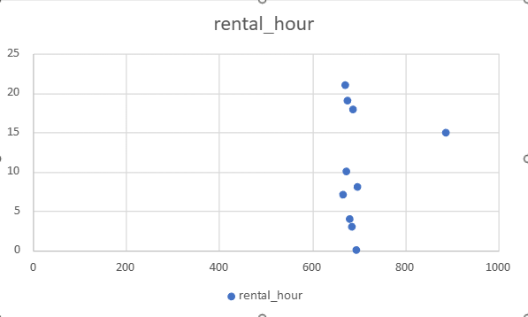
Visualization & Report
The Highest rentals occurred in 3PM – (887 rentals) indicating huge demand in Mid Afternoon.
The Lowest demand occurred in 7AM -(667 rentals) in Early Morning.

Slide 7
Recommendations:
The highest rentals occurred in 3PM. To increase sales in Early Morning have to give discounts or package discounts in Early Morning time.
Increasing staff availability around 3PM to manage customers.
Analyze why Early Morning time (7AM) have low rentals demand by conducting surveys.

Slide 8
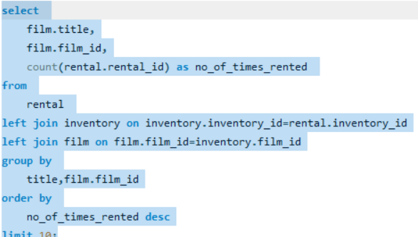
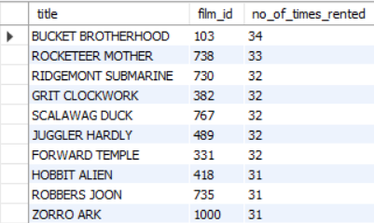
2. Film Popularity: a. Identify the top 10 most rented films.
Output:

Slide 9
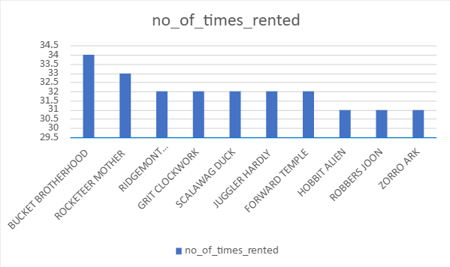
Visualization & Report
The Top Rented Movie was "Bucket Brother Hood" with 34 Rentals.
The Least Rented Movie was "Zorro Ark", "Robbers Zohn" and "Hobbit Alien" with 31 rentals.

Slide 10
Recommendations:
Increasing the availability of Bucket Brother Hood Movie in all stores with a title Most loved movie in this month.
Highlight the reviews and ratings of this movie to attract more customers on this rentals.
Marketing in social Media and giving discounts on this film.
Also taking surveys and feedbacks from the customers and stop the stocks of low rented movie for a while.

Slide 11
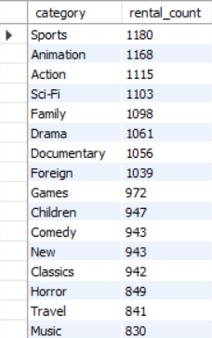
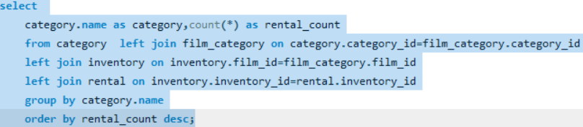
2. Film Popularity: b. Determine which film categories have the highest number of rentals.
Output:

Slide 12
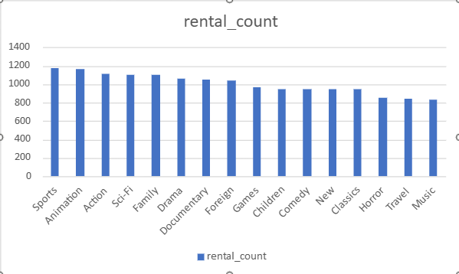
Visualization & Report
The most Rented Film Category was Sports with 1180 Rentals.

Slide 13
Recommendations:
Highlight the genre of the movie with most loved rental.
Also conducting AR/VR shots of the movie in the rental shop itself to increase more customers on this rental.
Giving Discounts to attract more customers.
Also the Low rental genre was music to increase sales of this genre conducting virtual experience of the music and also taking feedback from customers and plan according to the interest of the customers.

Slide 14
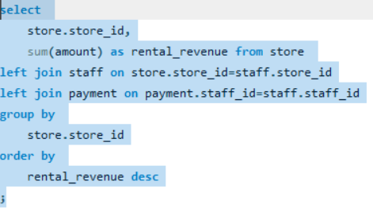

3. Store Performance: a. Identify which store generates the highest rental revenue.
Output:

Slide 15
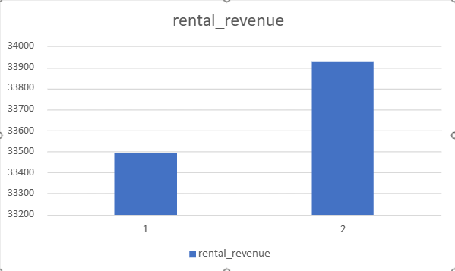
Visualization & Report
The Store 2 (33,927)has Highest Rental Revenue Compared to Store 1(33,489)

Slide 16
Recommendations:
Analyzing store 2 success factors like interacting with staffs of two stores about the possibilities of more rentals, locations of stores.
Review the stock and availability of high-demand films or categories in Store 2.

Slide 17
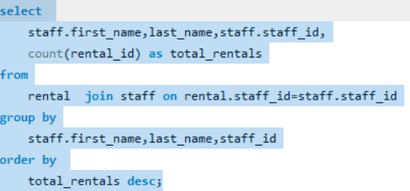

3. Store Performance: b. Determine the distribution of rentals by staff members to assess performance.
Table:

Slide 18
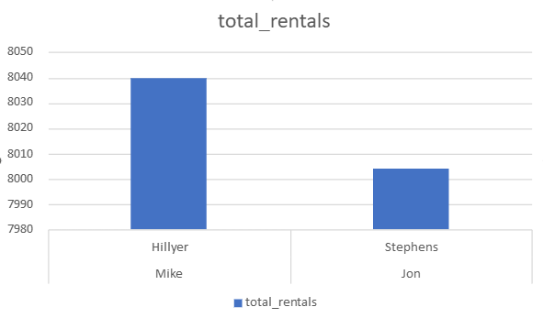
Visualization & Report
Mike Hillyer has the high distribution of rentals with(8040) as total rentals.
A very close Minimal difference(36) between the two having Jon Stephens with 8004 as total rentals.

Slide 19
Recommendations:
Recognize and reward the top performers.
A interaction is needed between the two staffs and get insights from each other.
To increase the other staff performers team workshop is needed through team meetings and trainings.

